Slide 1
Revvity Data Quality Tool

Slide 2
REVVITY DATA QUALITY TOOL
The Revvity Data Quality Tool (DQT) is an automated enterprise validation framework built to assess, cleanse, and standardize customer master data sourced from both PostgreSQL databases and Excel files.
It applies a robust multi-rule validation engine covering Name, Address, Region, Country, Postal, and City, ensures global compliance through ISO-based lookups, and generates a comprehensive, audit-ready Excel report enriched with validation results, statistics, and charts.
DQT supports real-time log streaming, web-based execution, and database upsert flows, providing a seamless end-to-end data quality assurance pipeline.

Slide 3
INTRODUCTION
The Data Quality Tool (DQT) is an automated validation framework designed to evaluate customer master data coming from two primary sources:
1. A PostgreSQL database (DB Mode)
2. An uploaded Excel file (Excel Mode)

Slide 4

The tool ensures the correctness of:
Customer Name
Address Line 1
City
Region Code
Country Code
Postal Code
It generates:
A detailed Excel validation report
Pass/Fail status for each rule
Remarks explaining failures
A summary sheet with statistics & charts
The tool also supports:
Live Log Streaming (SSE)
Report Download via UI
Centralized configuration
Database upsert of validated results

Slide 5
OBJECTIVES and KEY FEATURES
Automate customer master data validation
Provide consistent rule-based validation
Support real-time execution logs
Enable downloadable reports for audit tracking
Ensure accurate postal, region, and address validation for global customer data
Validate customer master records
Support DB Mode & Excel Mode
Country-wise postal regex validation
Region validation from DB reference table
Auto-generated Excel reports
Web UI with log console
Server-Sent Event live logs
Clean module separation (Core vs Web)

Slide 6
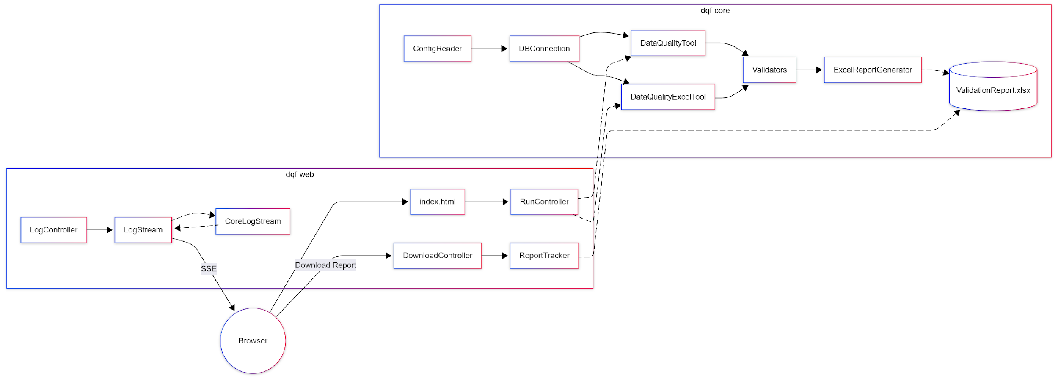
HIGH-LEVEL ARCHITECTURE

Slide 7
FUNCTIONAL FLOW
DB Mode
Step 1: User triggers DB Mode from UI.
Step 2: RunController invokes DataQualityTool.
Step 3: ConfigReader loads DB configuration.
Step 4: Tool connects to PostgreSQL and fetches rows.
Step 5: Validators process each record.
Step 6: ExcelReportGenerator produces output.
Step 7: Upsert operation stores validated results back to DB table data_quality_tool .
Step 8: ReportTracker stores latest report path.
Step 9: User downloads report from UI.

Slide 8
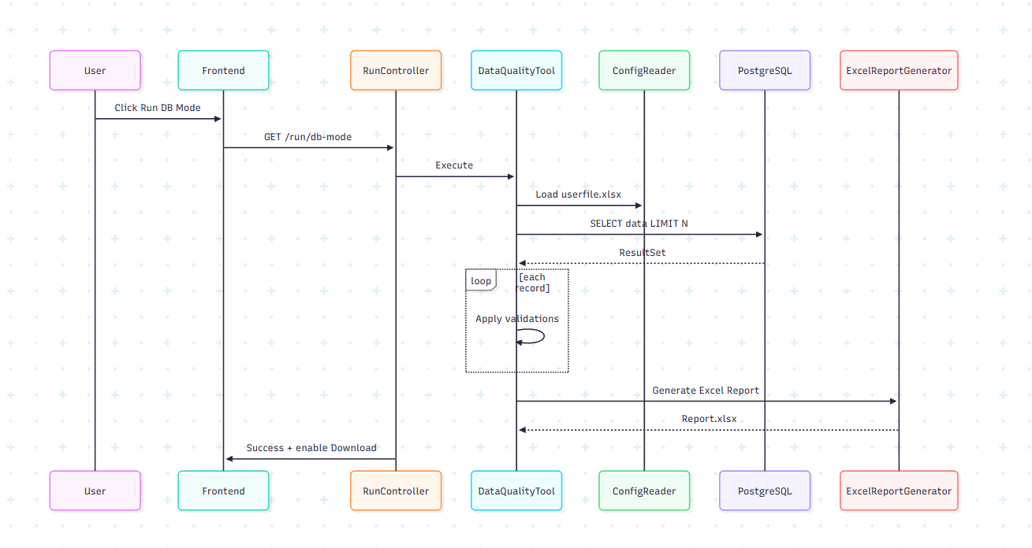
Architecture of DB Mode

Slide 9
FUNCTIONAL FLOW
Excel Mode
Step 1: User uploads Excel file.
Step 2: RunController stores file into temporary directory.
Step 3: DataQualityExcelTool loads config and parses the file.
Step 4: Header validation ensures correct template usage.
Step 5: Validators evaluate each record with DB lookups.
Step 6: Each valid record will be upserted to excel_ data_quality_tool table
Step 7: ExcelReportGenerator produces the final report with upsert logics
Step 8: ReportTracker stores generated report path.
Step 9: User downloads final report.

Slide 10
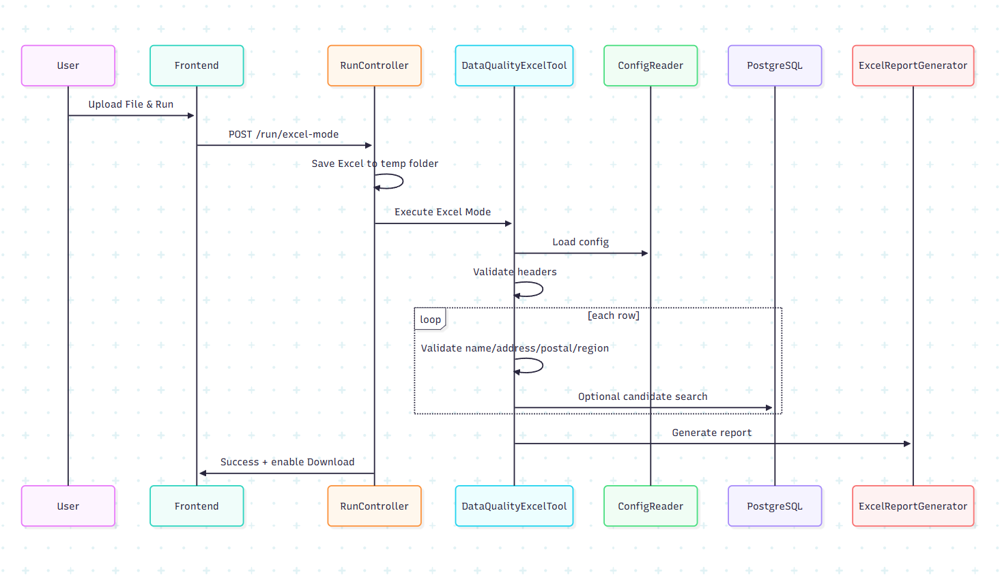
Architecture of Excel Mode

Slide 11
VALIDATION RULES
Name Validation
Name cannot be empty or null.
Length must be between 5 and 200 characters.
No special characters like (!,?, %).
Name cannot contain email-like patterns (@, .com, .in, .net, etc.)
Common Names like TEST, DEMO, SAMPLE are not allowed.
Sequential patterns like ABC or QWE are not allowed.

Slide 12
Address Validation
If Address Line 1 is null → invalid (no region added).
Otherwise, AddressLine1 = Address Line 1 + Region(Valid).
Minimum length: 10; Maximum length: 100.
Cannot have special characters (!, ?, %).
Only alphabets, numbers, commas, periods, and spaces are allowed.
Placeholder words like TEST or DEMO are rejected.
Sequential patterns like ABC or QWE are not allowed.

Slide 13
Region and Postal Code Validations
Region Validation
Uses DB table: country_region_postal_validation
Checks:
Valid country code (alpha2 or alpha3)
Whether region is mandatory
Region matches DB lookup list from country_region_postal code validation Table
Postal Code Validation
Postal Code cannot be empty or null if the country requires postel code uses DB table: country_region_postal_validation
Country must be a valid ISO 3166 name or code.
If a regex pattern exists for the country, it validates using that pattern.

Slide 14
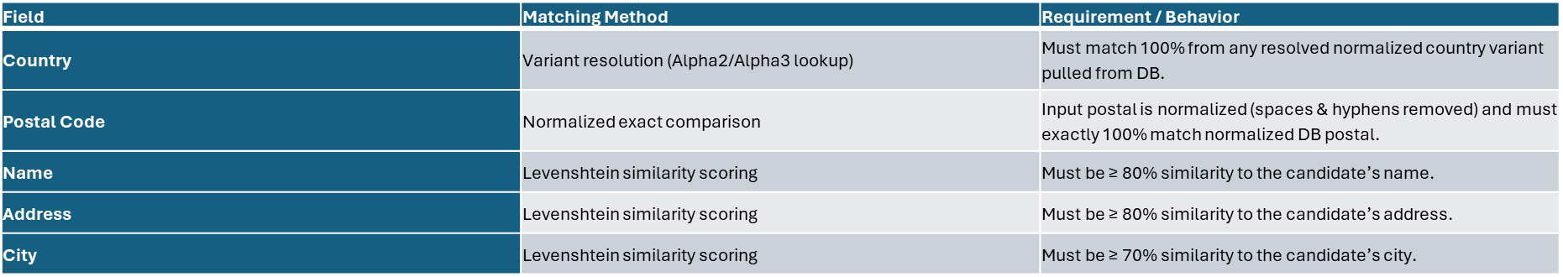
Fuzzy match with Customer Table for valid data to find the Valid Record is already Existed

Slide 15
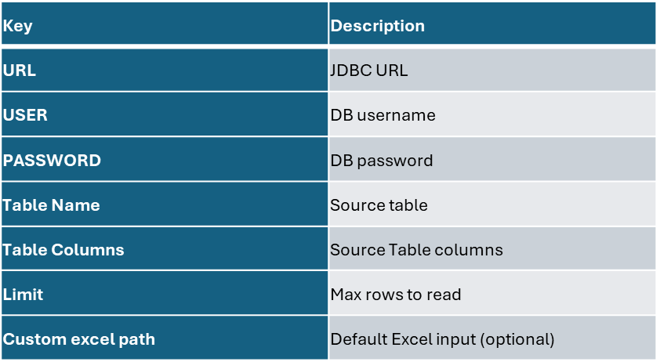
CONFIGURATION
All runtime settings come from userfile.xlsx:

Slide 16
Source Table (from configuration)
Columns (as per userfile.xlsx):
Id
Customer_name
Address_locality_line_1
Address_city
Region_code
Address_country_code
Address_postal_code
Duns_number

Slide 17
Primary Reference Table(country_region_postal_validation)
Columns:
alpha2code
alpha3code
ebxregioncode__regioncode
requires region
Requires Postel Code

Slide 18

Output Table for DB mode and Excel Mode
Output Table for DB mode
Table name : data_quality_check
Used in DB Mode to upsert validation results and the table can contain both valid and invalid records
Output Table for DB mode
Table name :exel_data_quality_check
Used in DB Mode to upsert validation results and the table contains only valid records

Slide 19

Report Generation
The report contains Detailed Data Sheet
Columns:
MDMID
Customer Name
Address
City
Region
Country
Postal Code
DUNS Number
Name Status
Address Status
Postal Status
Region Status
Record Validation
Remarks
Summary Table
Total Records
Pass %
Fail %
Per-field statistics
Chart Sheet
Bar chart of pass–fail % per validation

Slide 20
LIMITATIONS
Configuration stored in Excel
Populate the map with the expected column names and their common variations (aliases) Examples include:
Name1 → NAME1, NAME, CUSTOMER NAME, CLIENT NAME, COMPANY NAME, ACCOUNT NAME, ORGANIZATION NAME
Street/House → STREET/HOUSE, ADDRESS, ADDRESS LINE 1, STREET ADDRESS, LINE 1
City → CITY, TOWN, LOCATION, CITY NAME
Postal Code → POSTAL CODE, POSTAL, ZIP CODE, ZIP, PC
Country → COUNTRY, COUNTRY CODE, CUST_COUNTRY
Region → REGION, STATE, PROVINCE, STATE/PROVINCE, COUNTY
DUNS Number → DUNS NUMBER, DUNS, DUNS NO, DUNS#
No authentication on the web UI
Logging uses custom stream instead of SLF4J bridge
No pagination for large DB tables

Slide 21
CONCLUSION
The Data Quality Tool provides a complete enterprise-ready validation pipeline, supporting:
Excel & DB based validation
Real-time log streaming
Structured reporting
Modular architecture
Extensible validation layer

Slide 22

Thank You!

